Slide 1
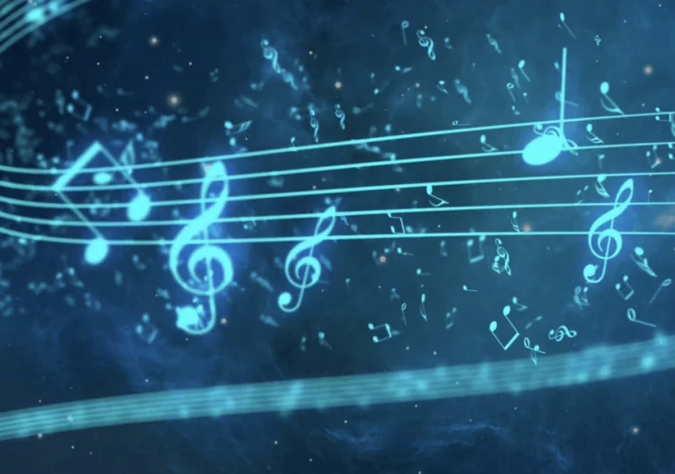
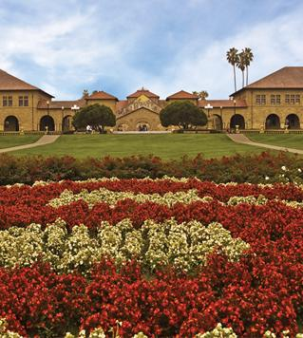
NSCNet – A Nightingale Songs Clustering Network
SIMONE MARASI GAETANO SIGNORELLI
DANIELE SIROCCHI

Slide 2
Deep Clustering
Classical clustering techniques struggle to find good results on high-dimensional data.
Deep Clustering is the combination of Deep Learning and classical clustering techniques.
The goal is to create groups of similar samples in an unlabeled dataset.
Most common techniques:
CNNs
Transformers
GANs
VAEs
And many others…

Slide 3
Dataset
Custom dataset of nightingale songs, kindly provided by Costalunga, G. (Ph.D. student at the Max Plank Institute of Biological Intelligence in Munich)
Composed by raw waveforms
Songs are about recordings of 36 nightingales coming from all over the world, from Berlin to Ghana
Divided in 2 channels:
CH1: set of previously recorded nightingale songs used as stimuli to induce the following singing (CH2)
CH2: the actual recording of a nightingale. It represents an answer to the stimulus arrived from CH1

Slide 4
Preliminary Steps
Steps required before starting the project implementation:
​Statistical Analysis on the data
Find a suitable encoding method for inputting raw waveforms into a ML/DL model
Decide which clustering algorithms to use
Preprocessing operations

Slide 5
Statistical Analysis
Performed on the five initially provided birds
Analyzed several features:
Amplitude
Duration
Zero-crossing rate
Frequency
Energy
Not big insights from this statistical analysis
Additional credit to a DL approach for automatically extracting relevant features

Slide 6
Encoding
Different ways for inputting an audio file into a ML/DL model:
Raw waveforms
Mel-Spectrograms and MFCC
Chromagrams

Slide 7
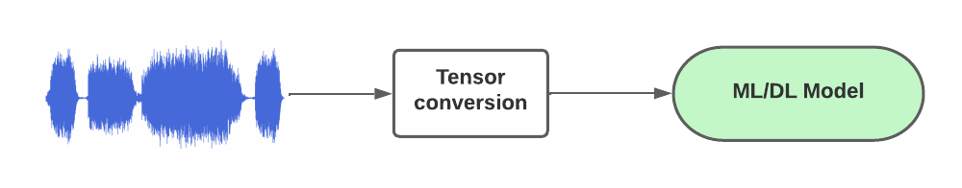
Encoding - Raw waveforms

Slide 8
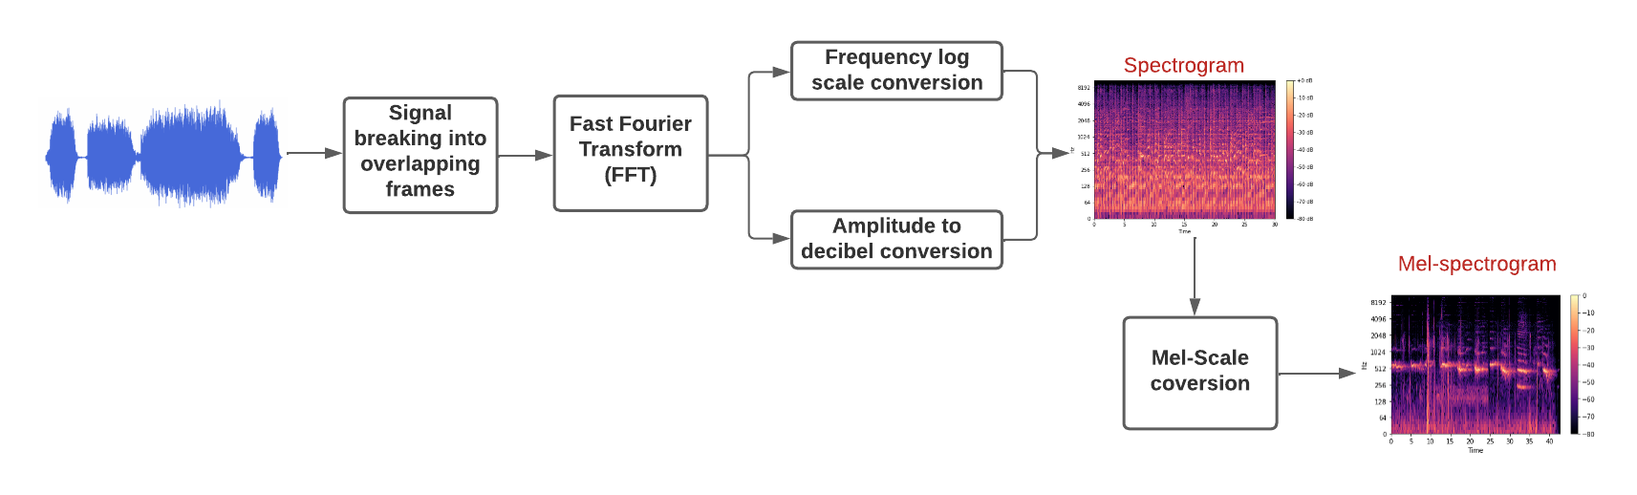
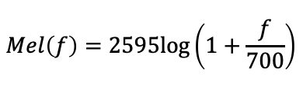
Encoding - Mel-Spectrograms
The most common way of audio encoding
An attempt of mimicking how humans hear sounds.
The final result is a RGB image
Reuse architectures for image processing
The chosen method for our project

Slide 9
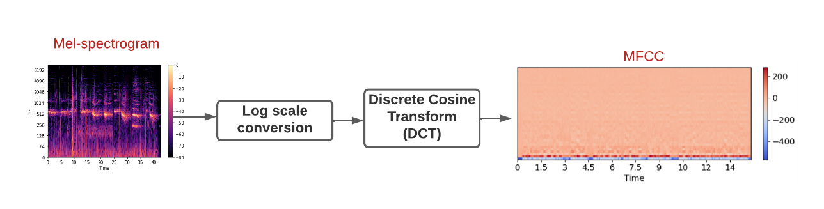
Encoding - MFCCs
Mel Frequency Cepstral Coefficients (MFCCs)
Another method based on the Mel-scale
Widely used for speech processing tasks

Slide 10
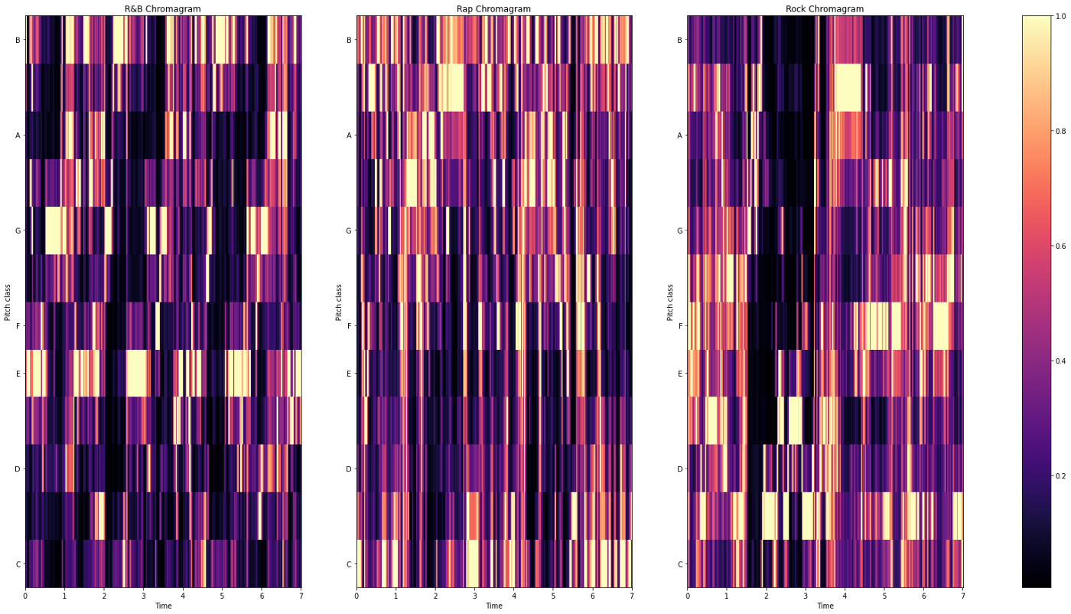
Encoding - Chromagrams
Based on pitches and octaves
Affinities with musical notes
Useful for many tasks related to music (e.g., as genre classification)
R&B
Rap
Rock

Slide 11
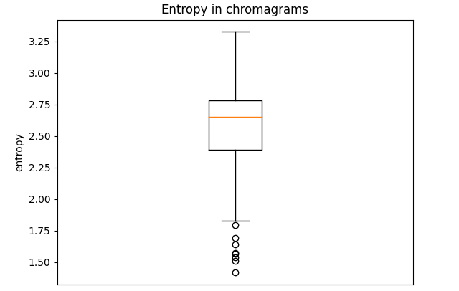
Encoding - Chromagrams
Could represent a valid alternative to Mel-Spectrograms
Nightingale songs can be approximately considered as pieces of music

Slide 12
Preprocessing
Padding and trimming has been applied on Mel-spectrograms, based on the average duration of the songs
Applied high-pass filter for noise removal
Image dimension fixed to 512x64 pixels
Other preprocessing operations are applied directly by each model during the training (e.g., whitening, normalization and standardization)

Slide 13
Clustering Methods
Many alternatives in the literature:
Partitioning-based (e.g., k-means)
Model-Based (e.g., Gaussian)
Hierarchical-based (e.g., agglomerative or divisive)
Density-based (e.g., DBSCAN)

Slide 14
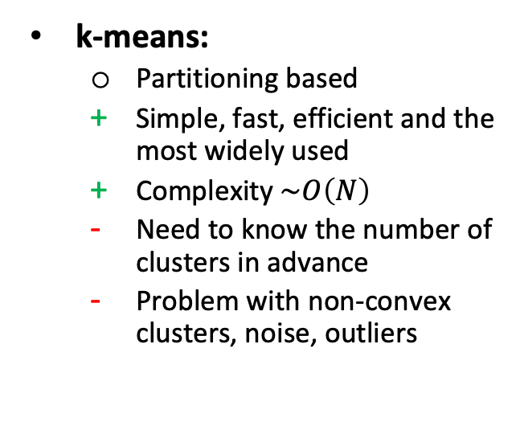
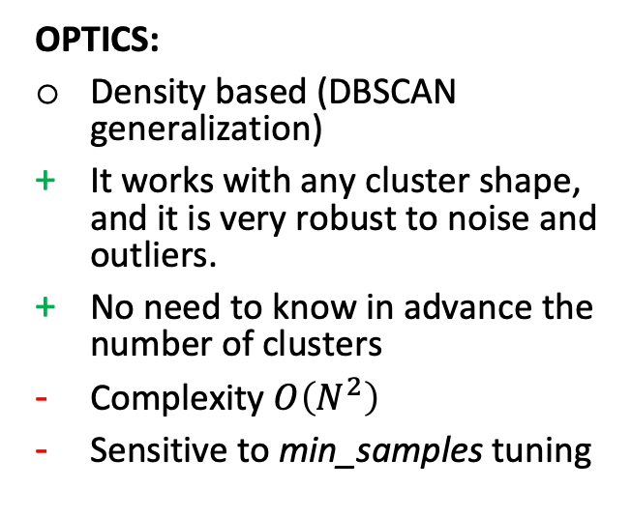
Clustering Methods - Our choices
k-means:
Partitioning based
Simple, fast, efficient and the most widely used
Complexity $\sim O\left(N\right)$
Need to know the number of clusters in advance
Problem with non-convex clusters, noise, outliers
OPTICS:
Density based (DBSCAN generalization)
It works with any cluster shape, and it is very robust to noise and outliers.
No need to know in advance the number of clusters
Complexity $O\left(N^{2}\right)$
Sensitive to min_samples tuning

Slide 15
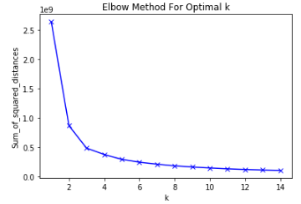
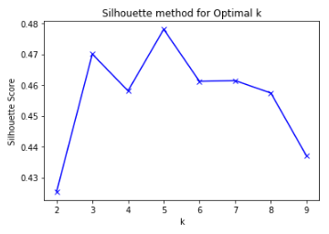
Clustering Methods - Evaluation Criteria
Inertia (elbow method)
How far away the points within a cluster are
Look for a slope change
Silhouette
How far away the datapoints in one cluster are WRT the datapoints in another cluster
Look for a peak
Slope change
Peak

Slide 16
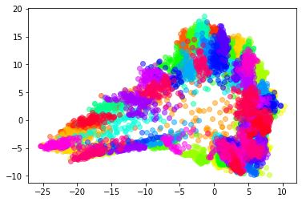
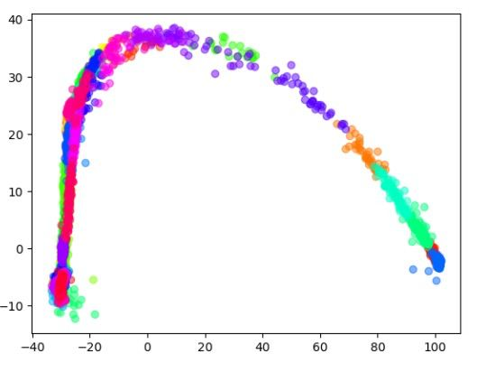
Clustering Methods – LDA Visualization
Linear Discriminant Analysis (LDA):
Typically used not only for dimensionality reduction (as PCA), but also for classification.
Exploit the generated labels for a better representation

Slide 17
Architectures
BASENet
VAENet
NSCNet

Slide 18
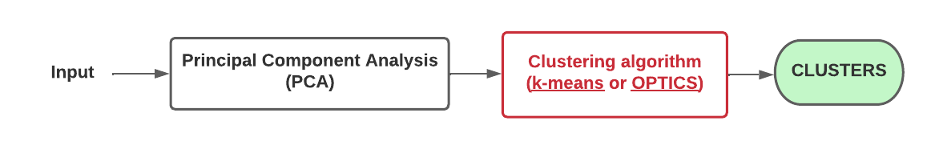
BASENet - Architecture Overview

Slide 19
BASENet – Experiments and Results
64, 128 and 256 dimensions for PCA, but no relevant difference noticed in the experiments
Clustering algorithms used:
k-means
OPTICS

Slide 20
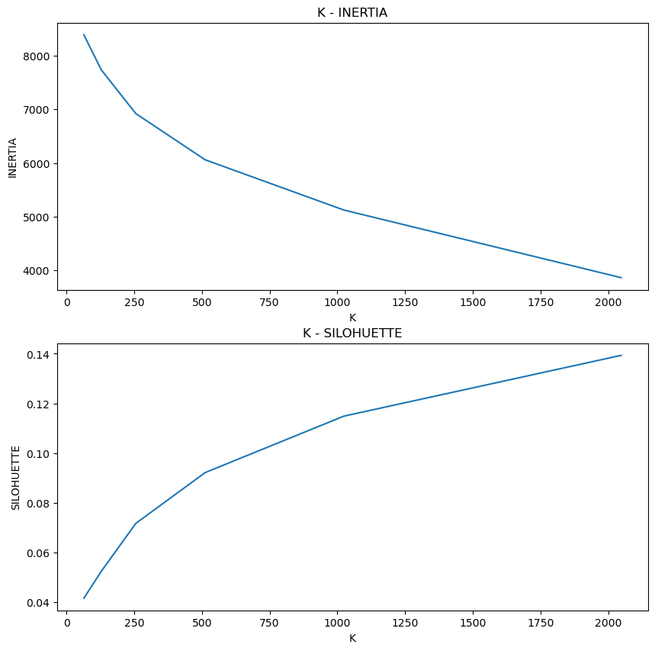
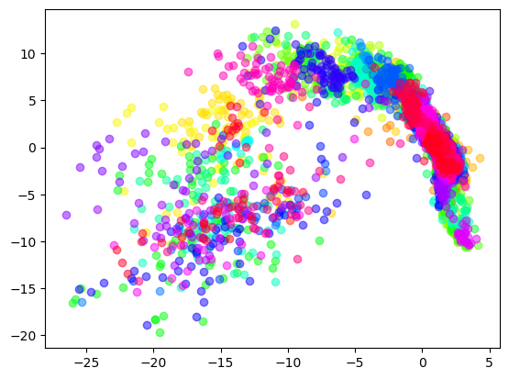
BASENet – Experiments and Results
k-means:
K-means LDA clusters visualization
K-means Inertia and Silhouette Score

Slide 21
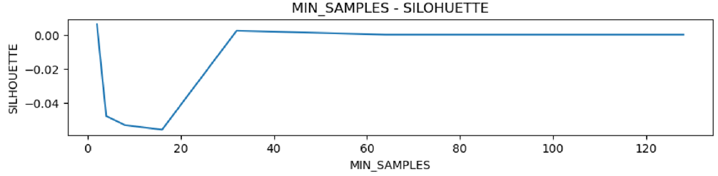
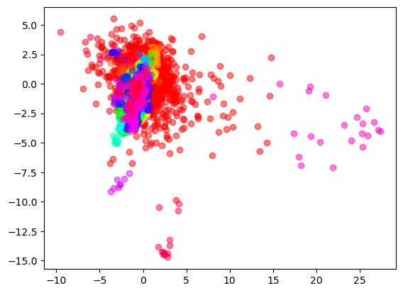
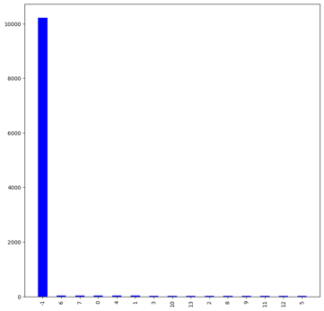
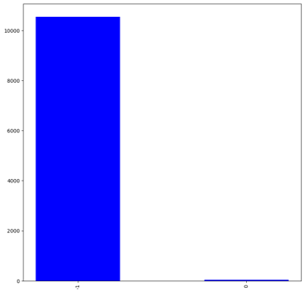
BASENet - Experiments and Results
OPTICS:
OPTICS Silhouette Score
OPTICS LDA clusters visualization
OPTICS sample distributions obtained varying min_samples

Slide 22
BASENet – Error analysis and future work
No great expectations from this architecture
Baseline results for other models
Images are very complex and high-dimensional data
Use different techniques for other models that can cope with this complexity
Required to increase model capacity

Slide 23
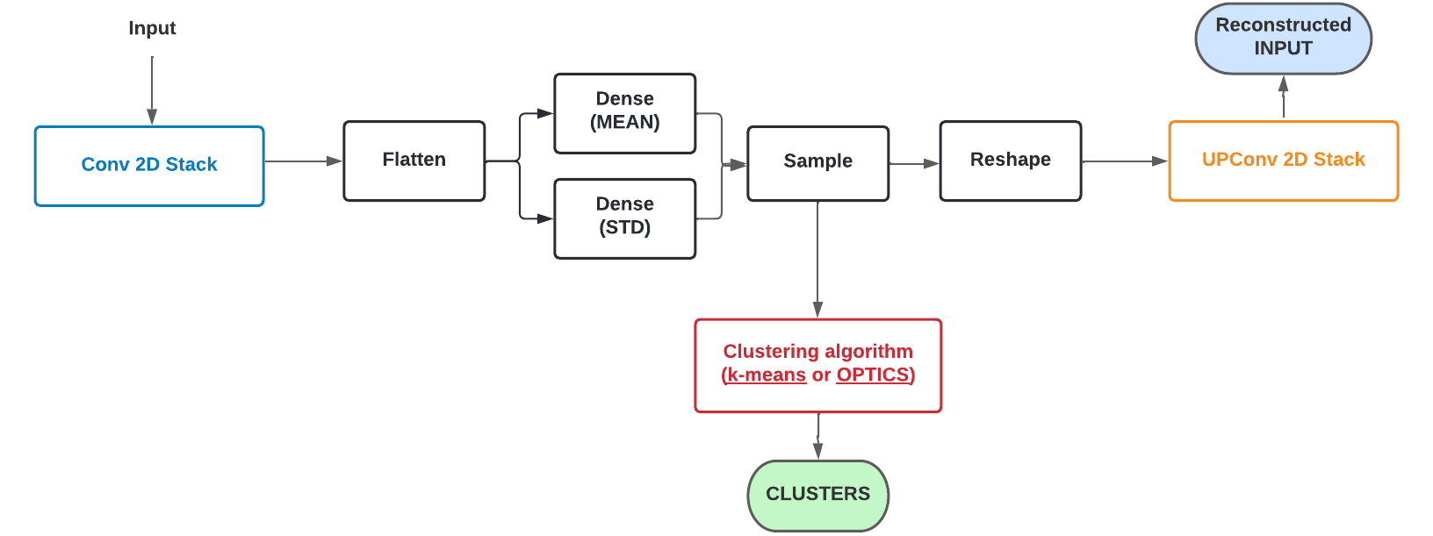
VAENet - Overview
ENCODER
DECODER

Slide 24
VAENet - Overview
USED ONLY IN STAGE 1
USED ONLY IN STAGE 2

Slide 25
VAENet - Experiments and Results
Tuned several hyper-parameters:
Number of convolutional filters in the encoder and decoder
Number of dense layers and their number of units
Tested also on images dataset (e.g., MNIST)
Clustering algorithms used:
k-means
OPTICS

Slide 26
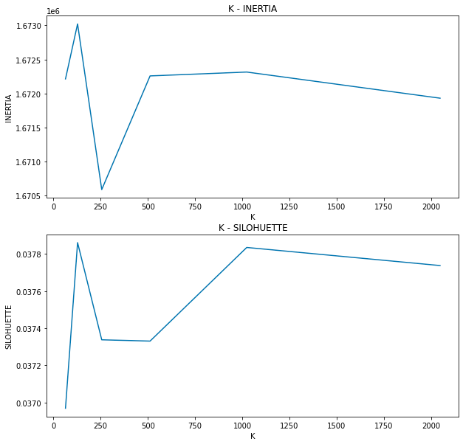
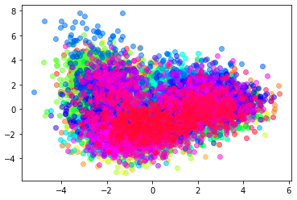
VAENet - Experiments and Results
k-means:
K-means LDA clusters visualization
K-means Inertia and Silhouette Score

Slide 27
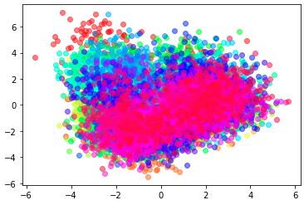
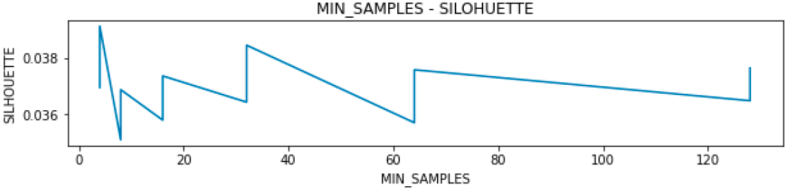
VAENet - Experiments and Results
OPTICS:
OPTICS Silhouette Score
OPTICS LDA clusters visualization

Slide 28




VAENet - Experiments and Results
Original Images
Reconstructed Images

Slide 29
VAENet - Error analysis and future work
Performances under our expectations
Loss stops decreasing quite early
Reconstructed images are blurred
Vanilla VAEs seem not suitable to work properly with Mel-spectrograms
Applying techniques that improve the reconstructed images could help to enhance the clustering results
Several architectures and statistical enhancements could be applied (e.g., pooling operations, residual links, use together with a GAN, …)

Slide 30
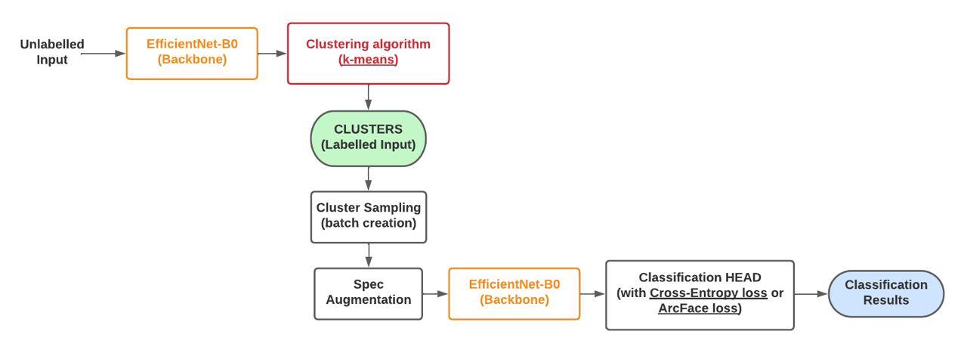
NSCNet - Architecture Overview

Slide 31
NSCNet - Architecture Overview

Slide 32
NSCNet - Architecture Overview

Slide 33
NSCNet - Architecture Overview

Slide 34
NSCNet - Architecture Overview

Slide 35
NSCNet - Architecture Overview

Slide 36
NSCNet - Architecture Overview

Slide 37
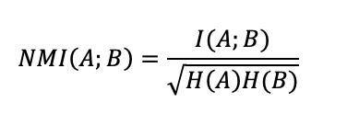
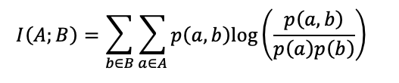
NSCNet - Training Details
Normalized Mutual Information (NMI) for early stopping:
2 different losses:
Softmax Loss (softmax followed by cross-entropy)
ArcFace Loss

Slide 38
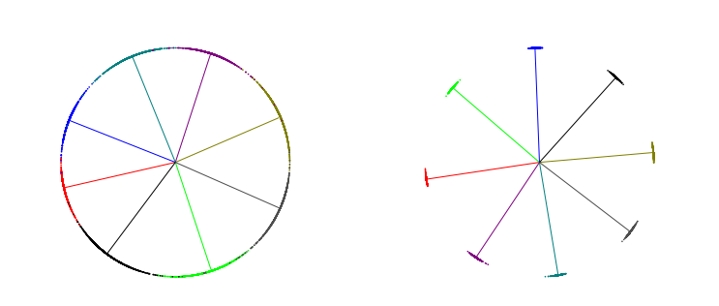
NSCNet - ArcFace Loss
Born for solving Face Recognition tasks
Modify the latent space:
Force high intra-class similarity
Force small inter-class similarity
2D features example with 8 possible classes (straight lines). On the left, the 2D features distribution when the cross-entropy loss is applied. On the right, the 2D features distribution when the ArcFace loss is used.

Slide 39
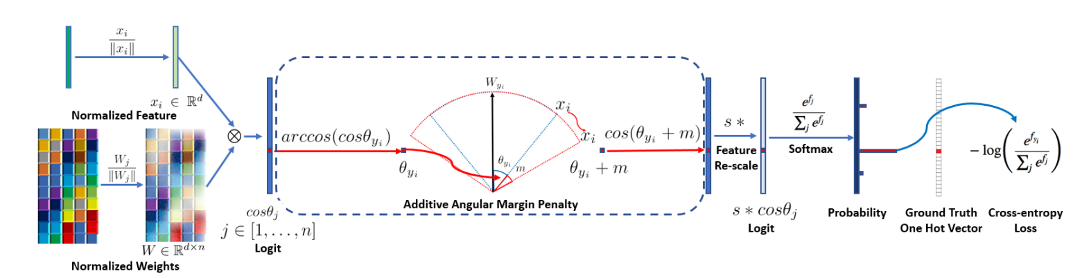
NSCNet - ArcFace Loss
Dot product

Slide 40
NSCNet - ArcFace Loss
Margin
Scale

Slide 41
NSCNet - ArcFace Loss

Slide 42
NSCNet - Experiments and Results
Used LeakyReLu for avoiding the «dying ReLU» effect
Operations computed before clustering:
Normalization (true or false)
PCA dimensionality reduction (128 or 256)
Whitening (true or false)
ArcFace Loss (true of false)
Epoch’s length (1 or 3)
Number of clusters K (64, 128, 256, 1024, 2048)

Slide 43
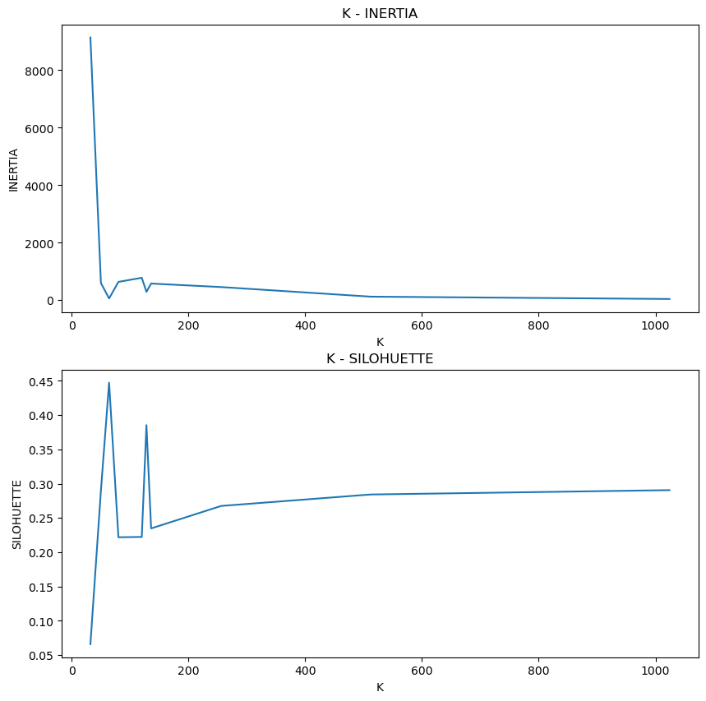
NSCNet - Experiments and Results
Slope change
K = 64
K = 128
Best Silhouette score
Secondary silhouette peak

Slide 44
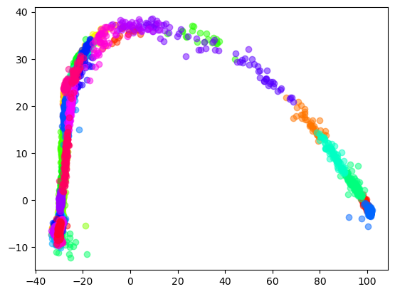
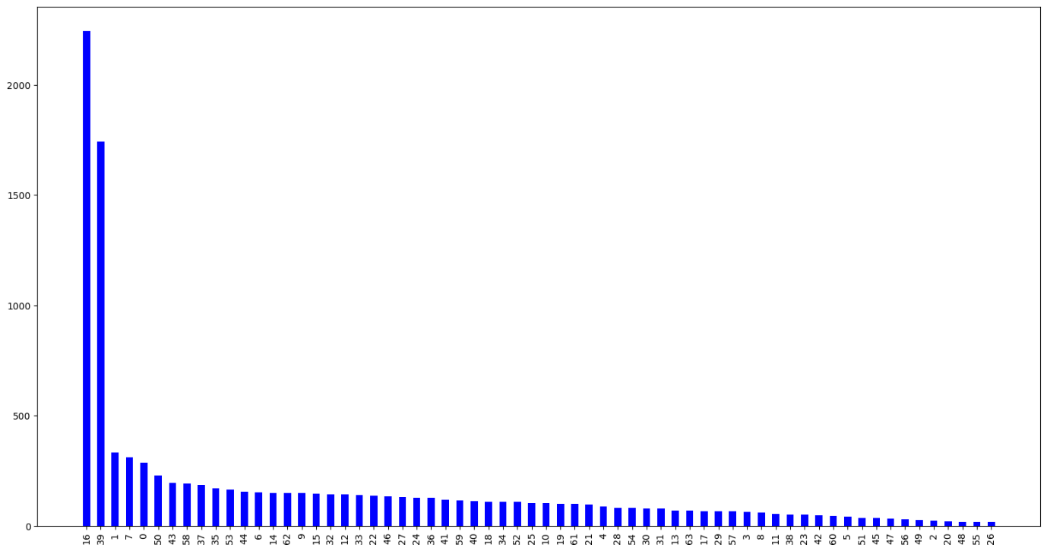
NSCNet - Experiments and Results
k-means sample distributions with K=64
K-means LDA clusters visualization with K=64

Slide 45
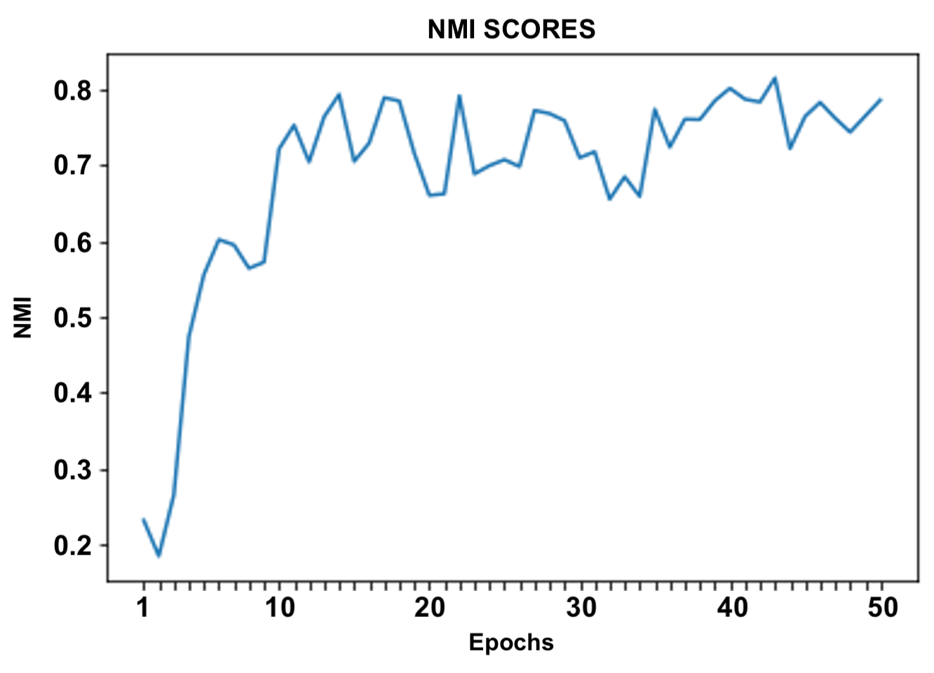
NSCNet - Experiments and Results

Slide 46
NSCNet - Zipf’s Law
The distribution of the data seems to follow a power-law
Zipf’s Law distribution of the data hypothesis
Affects several natural, biological and linguistical aspects of life (e.g., human languages)
Verified through 3 methods:
Plotting the expected distrubition
Kolmogorov-Smirnov test
Chi-squared test

Slide 47
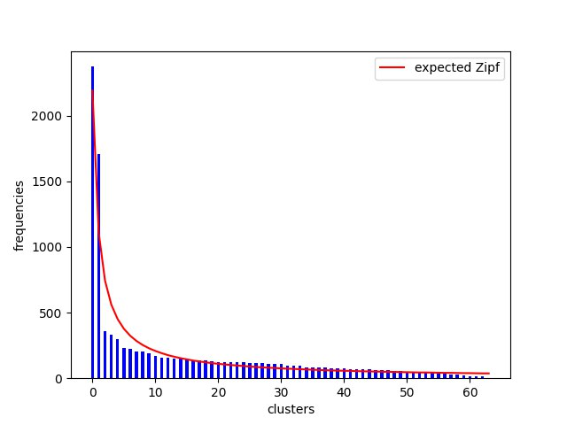
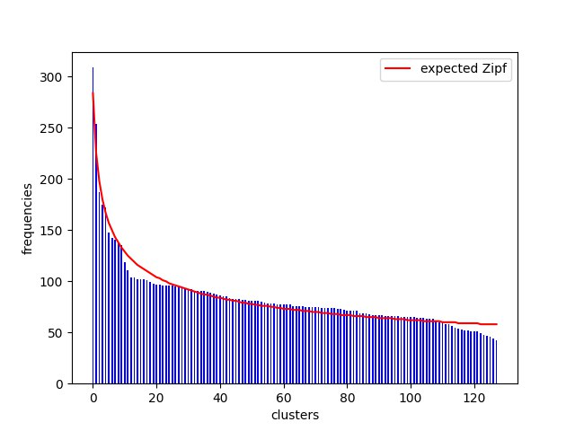
NSCNet - Zipf’s Law
K=64
K=128

Slide 48
NSCNet - Error analysis and future work
The deep clustering approach used seems to be strengthened by the Zipf’s law
Nightingales' songs may act as human languages
The dataset could be highly unbalanced
Probable under-representation of some songs
Contradict the expectation of having thousands of songs
Consider the silhouette as a way for evaluating how well clustered are the top-K clusters
Best results obtained between 64 and 128

Slide 49
NSCNet - Error analysis and future work
EfficientNet-B0 is probably too complex for the given dataset
Tune ArcFace’s margin and scale parameters
Train for more epochs
Substitute Mel-spectrograms with chromagrams or raw waveforms
Try other augmentation techniques

Slide 50
Conclusions
Implemented 3 different architectures and approaches: BASENet, VAENet and NSCNet
Experimented (as far as we know) a new loss applied to audio files
Found possible correlations between Nightingales’ songs and the Zipf’s Law
Audio input to DL/ML model is something new not seen in any other courses
Great opportunity to work on something completely out of our knowledge, supported by a domain expert
Special thanks to Federico Baldo and Giacomo Costalunga for their support

Slide 51
Thank you for your attention!

